Slide 1

Green Pace
Security Policy Presentation
Developer: Blake Buhr

Slide 2

OVERVIEW: DEFENSE IN DEPTH
Purpose of Security Policy
Establish consistent secure coding standards across Green Pace’s development team.
Identify and reduce vulnerabilities through coding practices, automated analysis, and testing.
Apply defense in depth by combining multiple security controls rather than relying on a single protection.
Standardize security expectations to support compliance, accountability, and future development.

Slide 3
THREATS MATRIX
Likely STD-003 – Buffer overflow STD-004 – SQL Injection STD-010 – Container bounds P18 – level 1 | Priority STD-001 – integer types STD-002 – Integer range STD-005 – User-after-free STD-006 – Assertions STD-008 – Expressions STD-009 – Uninitialized memory P12 – Level 1
Low priority STD-007 – Exception handling P8 – Level 2 | Unlikely No standards currently assess as unlikely

Slide 4
10 PRINCIPLES
Security principle | Applicable standards
1. Validate input data | STD-002, 003, 006, 010
2. Heed compiler warnings | STD-001, 008, 009
3. Architect and design for security policies | STD-005, 007
4. Keep it simple | STD-001, 003, 005, 008, 009
5. Default deny | STD-002, 007, 010
6. Least privilege | STD-004
7. Sanitize data sent to other systems | STD-004
8. Practice defense in depth | STD-003, 004, 007, 010
9. Effective quality assurance techniques | STD-002, 005, 006, 009
10. Adopt a secure coding standard | STD-001, 006, 008

Slide 5
CODING STANDARDS
Coding Standard | Score | Level
STD-003 – Sufficient String Storage | 18 | 1
STD-004 – Parameterized SQL Queries | 18 | 1
STD-010 – Container Index Bounds | 18 | 1
STD-001 – Appropriate Integer Types | 12 | 1
STD-002 – Integer Range Validation | 12 | 1
STD-005 – Avoid Free Memory Access | 12 | 1
STD-006 – Assertions and Runtime Checks | 12 | 1
STD-008 – Avoid Multiple Changes in Expressions | 12 | 1
STD-009 – Avoid Uninitialized Memory | 12 | 1
STD-007 – Handle All Exceptions | 8 | 2

Slide 6
ENCRYPTION POLICIES
Encryption category | Green Pace policy
Data at Rest | Encrypt sensitive stored data using AES-256. Protect encryption keys separately from the data.
Data in Transit | Require TLS 1.3 for supported network communications. Validate certificates and prohibit insecure connections.
Data in Use | Minimize plaintext exposure in memory. Restrict access, clear sensitive buffers when appropriate, and use hardware-backed protections where needed.
Key Management: Restrict key access, use approved key-management systems, and rotate or replace keys according to policy.
These are proposed Green Pace encryption requirements, rather than claims that Green Pace already has these controls deployed.

Slide 7
TRIPLE-A POLICIES
Policy | Green Pace security requirements
Authentication – Who are you? | Require unique user accounts, strong authentication, and MFA for privileged access.
Authorization – What can you do? | Enforce least privilege, role-based access control, and default-deny permissions.
Account – What did you do? | Log authentication attempts, access changes, and security-relevant activities. Protect logs against tampering.
Security Goal: Ensure access is verified, restricted, and auditable.

Slide 8
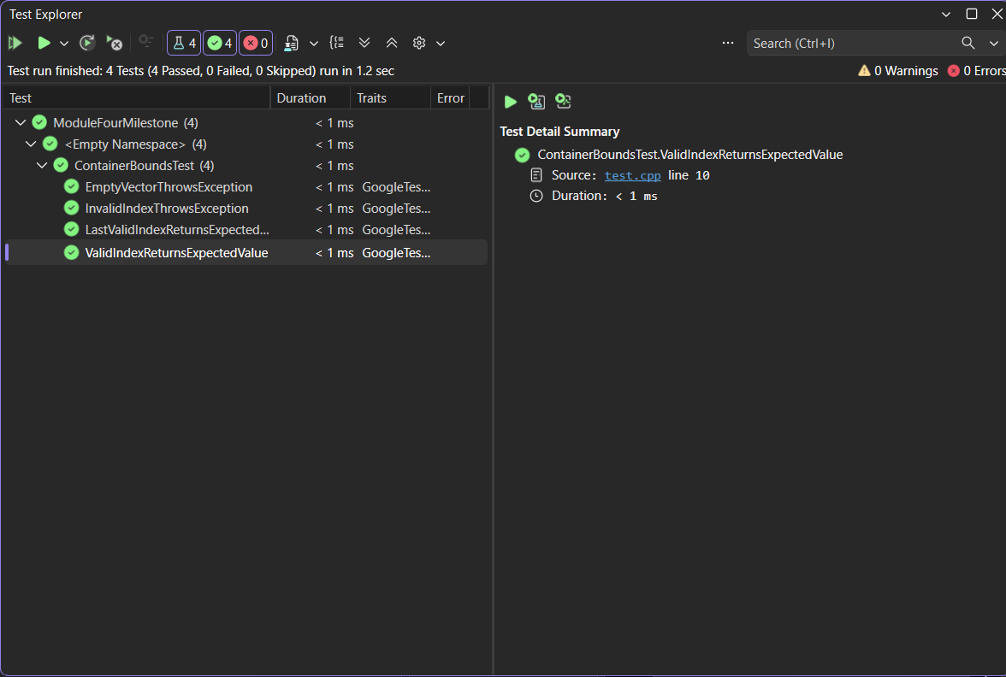
Does a Valid Index Return the Expected Value?
Coding Standard: STD-010-CPP – Keep Container Indices Within Range
Test: ValidIndexReturnsExpectedValu
Input: Vector {10, 20, 30}, index 1
Expected Result: Return 20
Actual Result: Returned 20
Outcome: PASS – Valid index access succeeded.

Slide 9
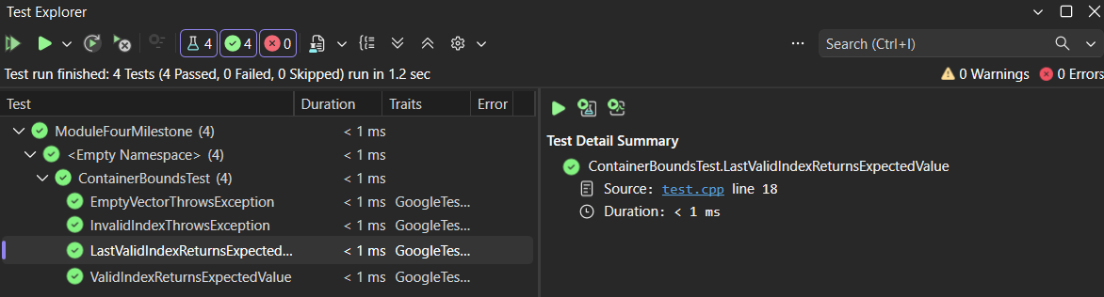
Does the Last Valid Index Return the Expected Value?
Coding Standard: STD-010-CPP – Keep Container Indices Within Range
Test: LastValidIndexReturnsExpectedValue
Input: Vector {10, 20, 30}, index 2
Expected Result: Return 30
Actual Result: Test passed; returned value matched 30
Outcome: PASS – Last valid index accessed successfully

Slide 10
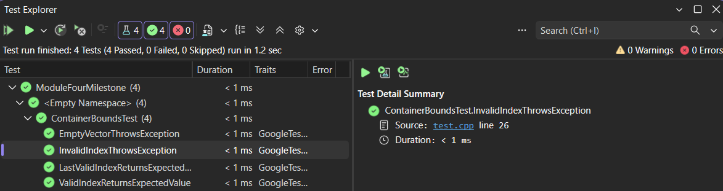
Does an Invalid Index Trigger an Exception?
Coding Standard: STD-010-CPP – Keep Container Indices Within Range
Test: InvalidIndexThrowsException
Input: Vector {10, 20, 30}, index 3
Expected Result: Throw std::out_of_range
Actual Result: Expected exception was thrown.
Outcome: PASS – Invalid Index access was detected.

Slide 11
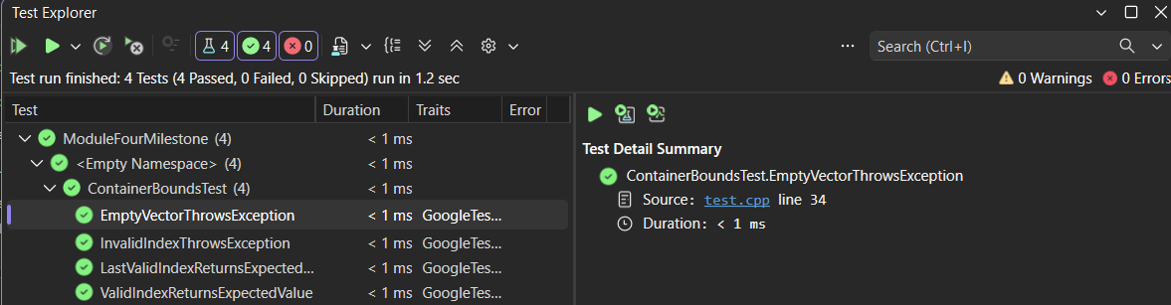
Does Accessing an Empty Vector Trigger an Exception?
Coding Standard: STD-010-CPP – Keep Container Indices Within Range
Test: EmptyVectorThrowsException
Input: Empty vector {}, index 0
Expected Result: Throw std::out_of_range
Actual Result: Expected exception was thrown.
Outcome: PASS – Empty container access was detected.

Slide 12

AUTOMATION SUMMARY
Green Pace Automated Security Workflow
Code: Developers follow secure coding standards.
Build: Compiler warnings and static analysis identify potential vulnerabilities.
Test: Unit tests and AddressSanitizer check application behavior and memory safety.
Security Scan: OWASP ZAP tests authorized application endpoints for vulnerabilities.
Review: Developers investigate findings and correct confirmed issues.
Release: Approved builds proceed through deployment controls.
Goal: Identify vulnerabilities early and repeat
security checks throughout development.

Slide 13
TOOLS
Tool | Pipeline stage | Purpose
Clang Compiler | Build | Detect unsafe conversions and suspicious expressions
Clang Static Analyzer | Code analysis | Identify potential memory and logic defects
GoogleTest | Unit testing | Verify correct behavior and invalid-input handling
AddressSanitizer | Runtime testing | Detect certain buffer overflows and memory errors
OWASP ZAP | Security testing | Scan authorized web applications for vulnerabilities
  DevSecOps: Integrate automated security checks into development, testing, and deployment.

Slide 14
RISKS AND BENEFITS
Area | Key points
Risks of Delaying | Vulnerabilities remain exposed; potential data breaches, service disruptions, and higher remediation costs.
Benefits of Acting Now | Earlier vulnerability detection, consistent coding practices, reduced security exposure, and more reliable software.
Strategy Limitations | Automated tools can miss vulnerabilities or produce false positives; implementation requires time, training, and ongoing maintenance.
Next Steps: Prioritize high-risk vulnerabilities, integrate automated checks, and review findings before release.

Slide 15
RECOMMENDATIONS
Recommended Security Policy Improvements
Define Enforcement: Establish mandatory security checks and release approval criteria.
Expand Coverage: Add standards for dependency management, secrets, and secure configuration.
Improve Testing: Require regular security testing and documented remediation.
Maintain the Policy: Assign ownership, provide developer training, and schedule periodic reviews.
Priority: Implement mandatory checks first, then expand and maintain security coverage.

Slide 16
CONCLUSIONS
Green Pace Security Policy – Key Takeaways
Adopt all ten secure coding standards across C/C++ development.
Prioritize buffer safety, SQL injection prevention, and container bounds checking.
Integrate automated security testing throughout development.
Enforce encryption, access controls, and security review requirements.
Maintain and update the policy as threats and technologies evolve.
Conclusion: Secure development requires consistent standards, layered defenses, and continuous improvement.

Slide 17
REFERENCES
References
GoogleTest. (n.d.). GoogleTest primer. https://google.github.io/googletest/primer.html
LLVM Project. (n.d.). AddressSanitizer. https://releases.llvm.org/18.1.8/tools/clang/docs/AddressSanitizer.html
OWASP Foundation. (n.d.). Authentication cheat sheet. https://cheatsheetseries.owasp.org/cheatsheets/Authentication_Cheat_Sheet.html
OWASP Foundation. (n.d.). Authorization cheat sheet. https://cheatsheetseries.owasp.org/cheatsheets/Authorization_Cheat_Sheet.html
OWASP Foundation. (n.d.). Cryptographic storage cheat sheet. https://cheatsheetseries.owasp.org/cheatsheets/Cryptographic_Storage_Cheat_Sheet.html
OWASP Foundation. (n.d.). Logging cheat sheet. https://cheatsheetseries.owasp.org/cheatsheets/Logging_Cheat_Sheet.html
OWASP Foundation. (n.d.). SQL injection prevention cheat sheet. https://cheatsheetseries.owasp.org/cheatsheets/SQL_Injection_Prevention_Cheat_Sheet.html
OWASP Foundation. (n.d.). Transport layer security cheat sheet. https://cheatsheetseries.owasp.org/cheatsheets/Transport_Layer_Security_Cheat_Sheet.html
Software Engineering Institute. (n.d.). CTR50-CPP: Guarantee that container indices and iterators are within the valid range. CERT Secure Coding. https://cmu-sei.github.io/secure-coding-standards/sei-cert-cpp-coding-standard/rules/containers-ctr/ctr50-cpp/
ZAP. (n.d.). SQL injection alert 40018. https://www.zaproxy.org/docs/alerts/40018/

